Slide 1
EID101E
Diabetes Testing and Education in Kampala
Professor Anita Raja
Notes:
Emily
Section E

Slide 2
What is Diabetes?
Problem Formulation
Affects body’s natural ability to manage insulin
High blood glucose
Type 2 diabetes focus
Notes:
Emily
Diabetes occurs in individuals when blood glucose is too high and the body cannot produce or produce enough insulin, the hormone which converts the glucose in food to be used in cells. When this occurs the body goes through ketoacidosis, in which fat is used to supply energy for cellular processes. There are two types of diabetes - type 1 and type 2. In type 1, the body does not make insulin. In type 2, the body does not make or use insulin well.

Slide 3
Problem Statement
Problem Formulation
In Kampala, Uganda, there is no affordable and effective way to measure blood glucose levels for diabetics and very little widespread education about diabetes.
Notes:
Harper
In Kampala, there’s no affordabe way for the masses test test bloodglucose levels
Furthermore, there is very little education around diabetes prevention and treatment

Slide 4
Design Considerations
Problem Formulation
SUSTAINABILITY
LOW COST
EASE OF USE
SAFETY
CULTURAL SENSITIVITY
Notes:
Harper
Cost
Sustainability
Ease of use
Safety
Cultural sensitivity

Slide 5
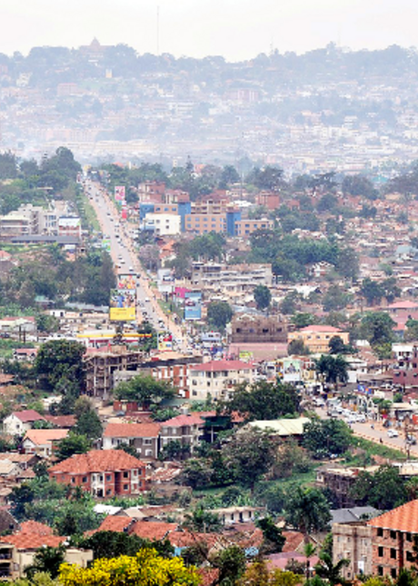
Target: Kampala, Uganda
Needs Assessment
Background
4.2% ~60,000
Diabetic Prevalence
$287.62
Average Monthly Household Income
Notes:
Radi
Our Target is to help the poeple of Kampala Uganda with monitering their diabetes. Due to increased globalization, aging population, rapid urbanization, and increasingly sedentary nations, diabetes has been
Very high rate of prevalence, and rate is increasing
Problem is compounded by low monthly income, which oftentimes prevents people from accessing the care that they need
We have discussed with experts from Johnson and Johnson and from Albert Einstein College of medicine, and they said that

Slide 6
Engineering Design Process
Abstraction / Synthesis
Needs Assessment
Implementation
Problem Formulation
Analysis and Evaluation
Abstraction and Synthesis
Notes:
This is the engineering design process that I am sure all of you are familiar with. Most of our groups have assessed the current problem facing them in kampala (point to needs assessment), developed a problem statement (point to problem formulation), and have moved on to the abstraction and synthesis portion of the design process. Each group will individually discuss this aspect of the design process further.
Josh

Slide 7
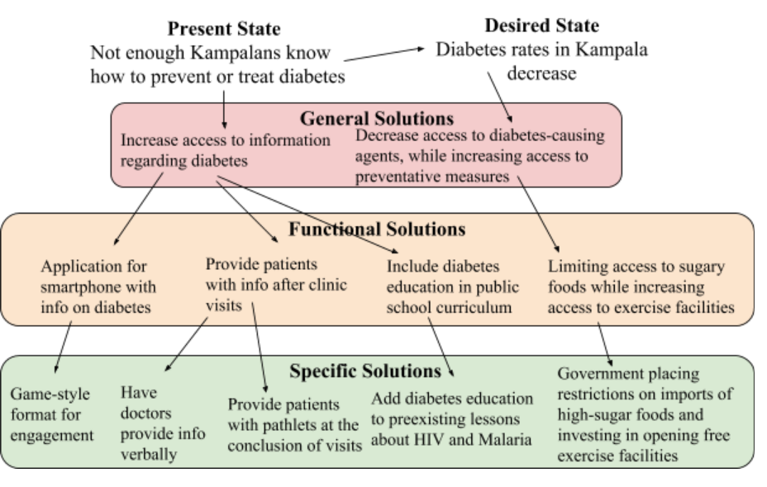
Duncker Diagram

Slide 8
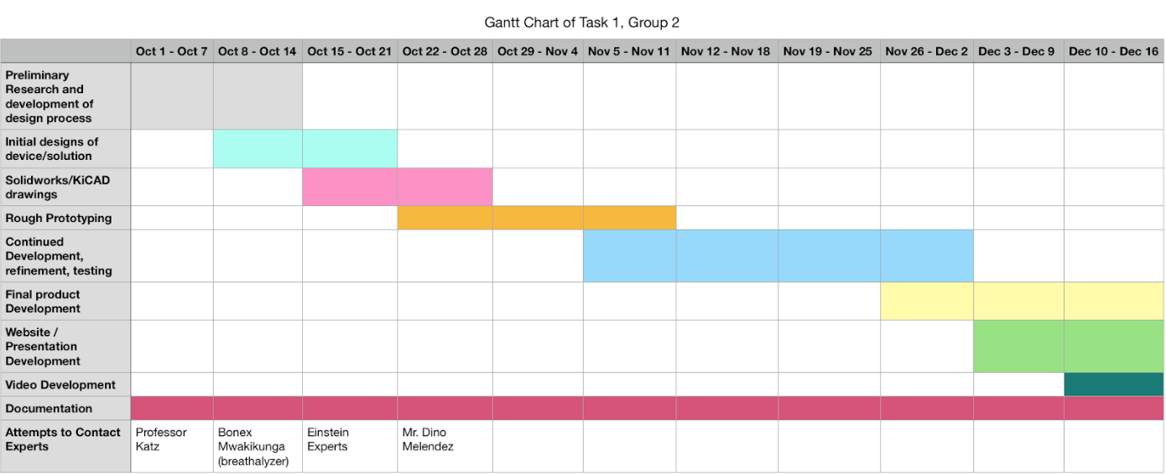
Continued Development: Task 1
Notes:
Continued plans for the future, where are you going to take your presentation?
Work that has to be done: we still have to verify the circuit design and begin basic prototyping processes. We also have to solve the problem of human testing.

Slide 9
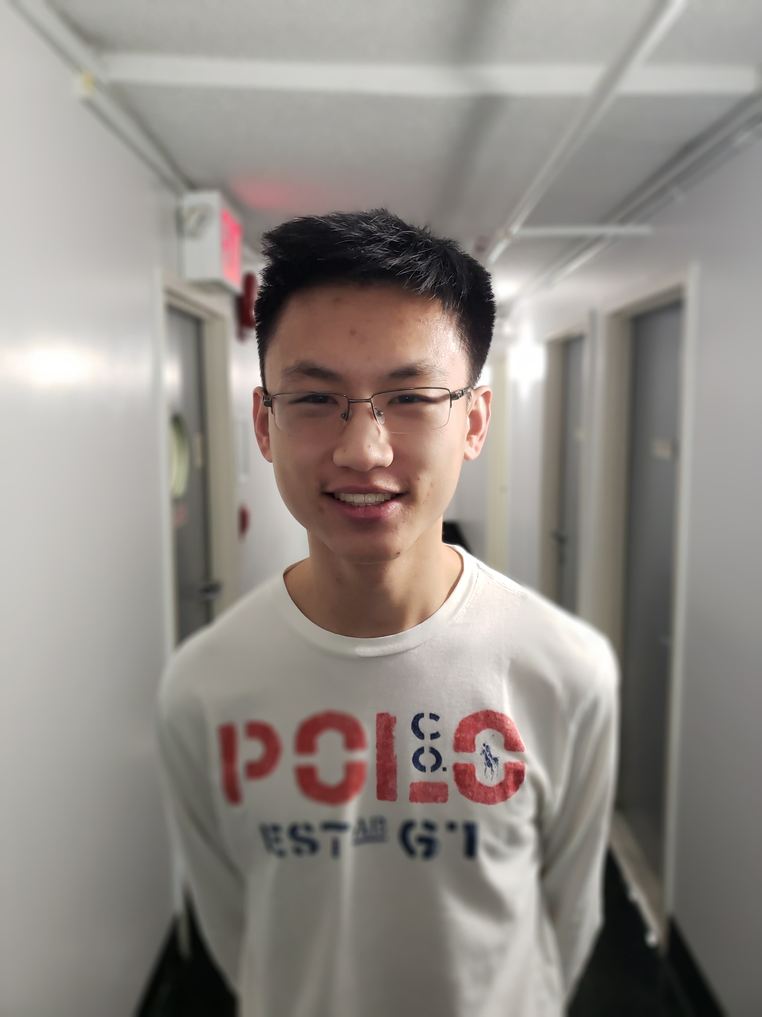


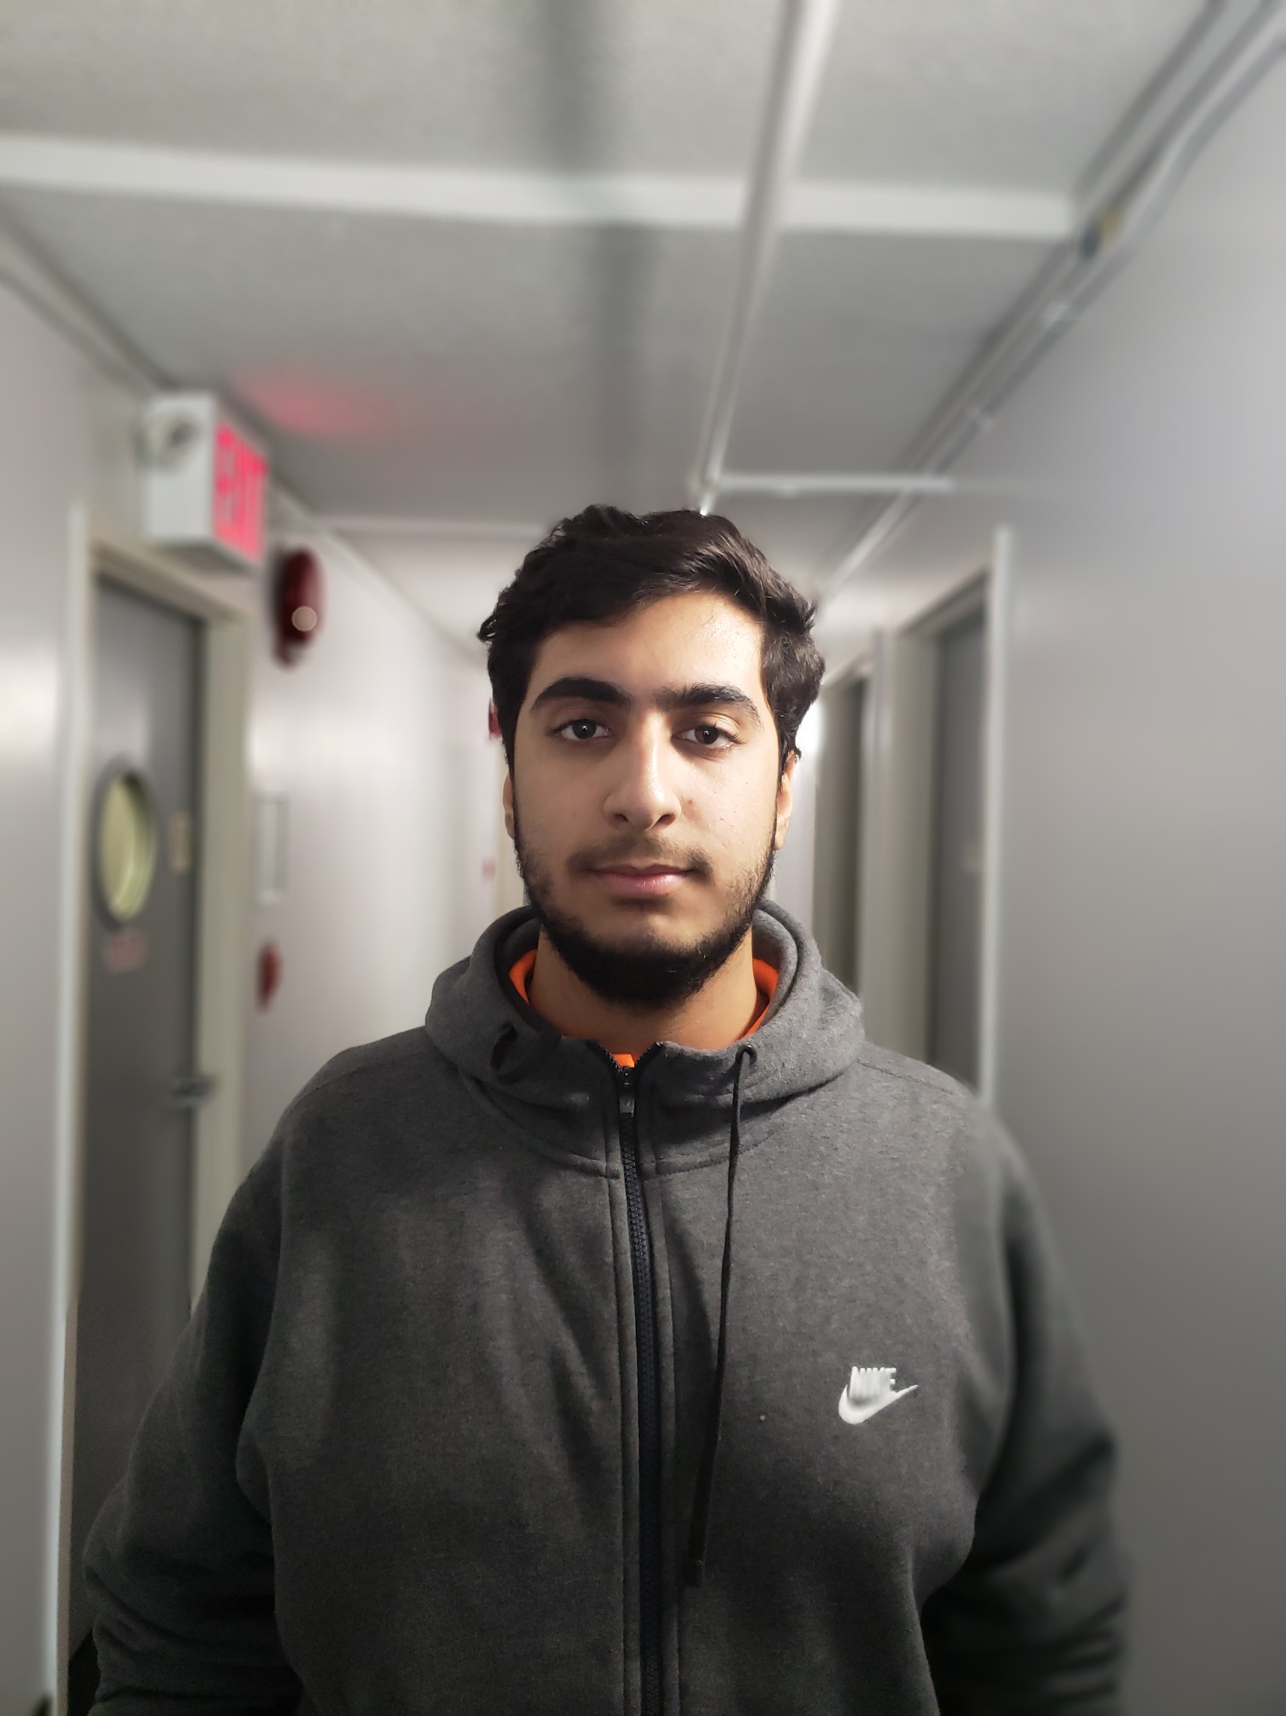
Task 1: Blood Glucose Testing
Group 1
Group 2
Jon L.
Emily Y.
Joshua Y.
Radi F.
Notes:
Pia

Slide 10



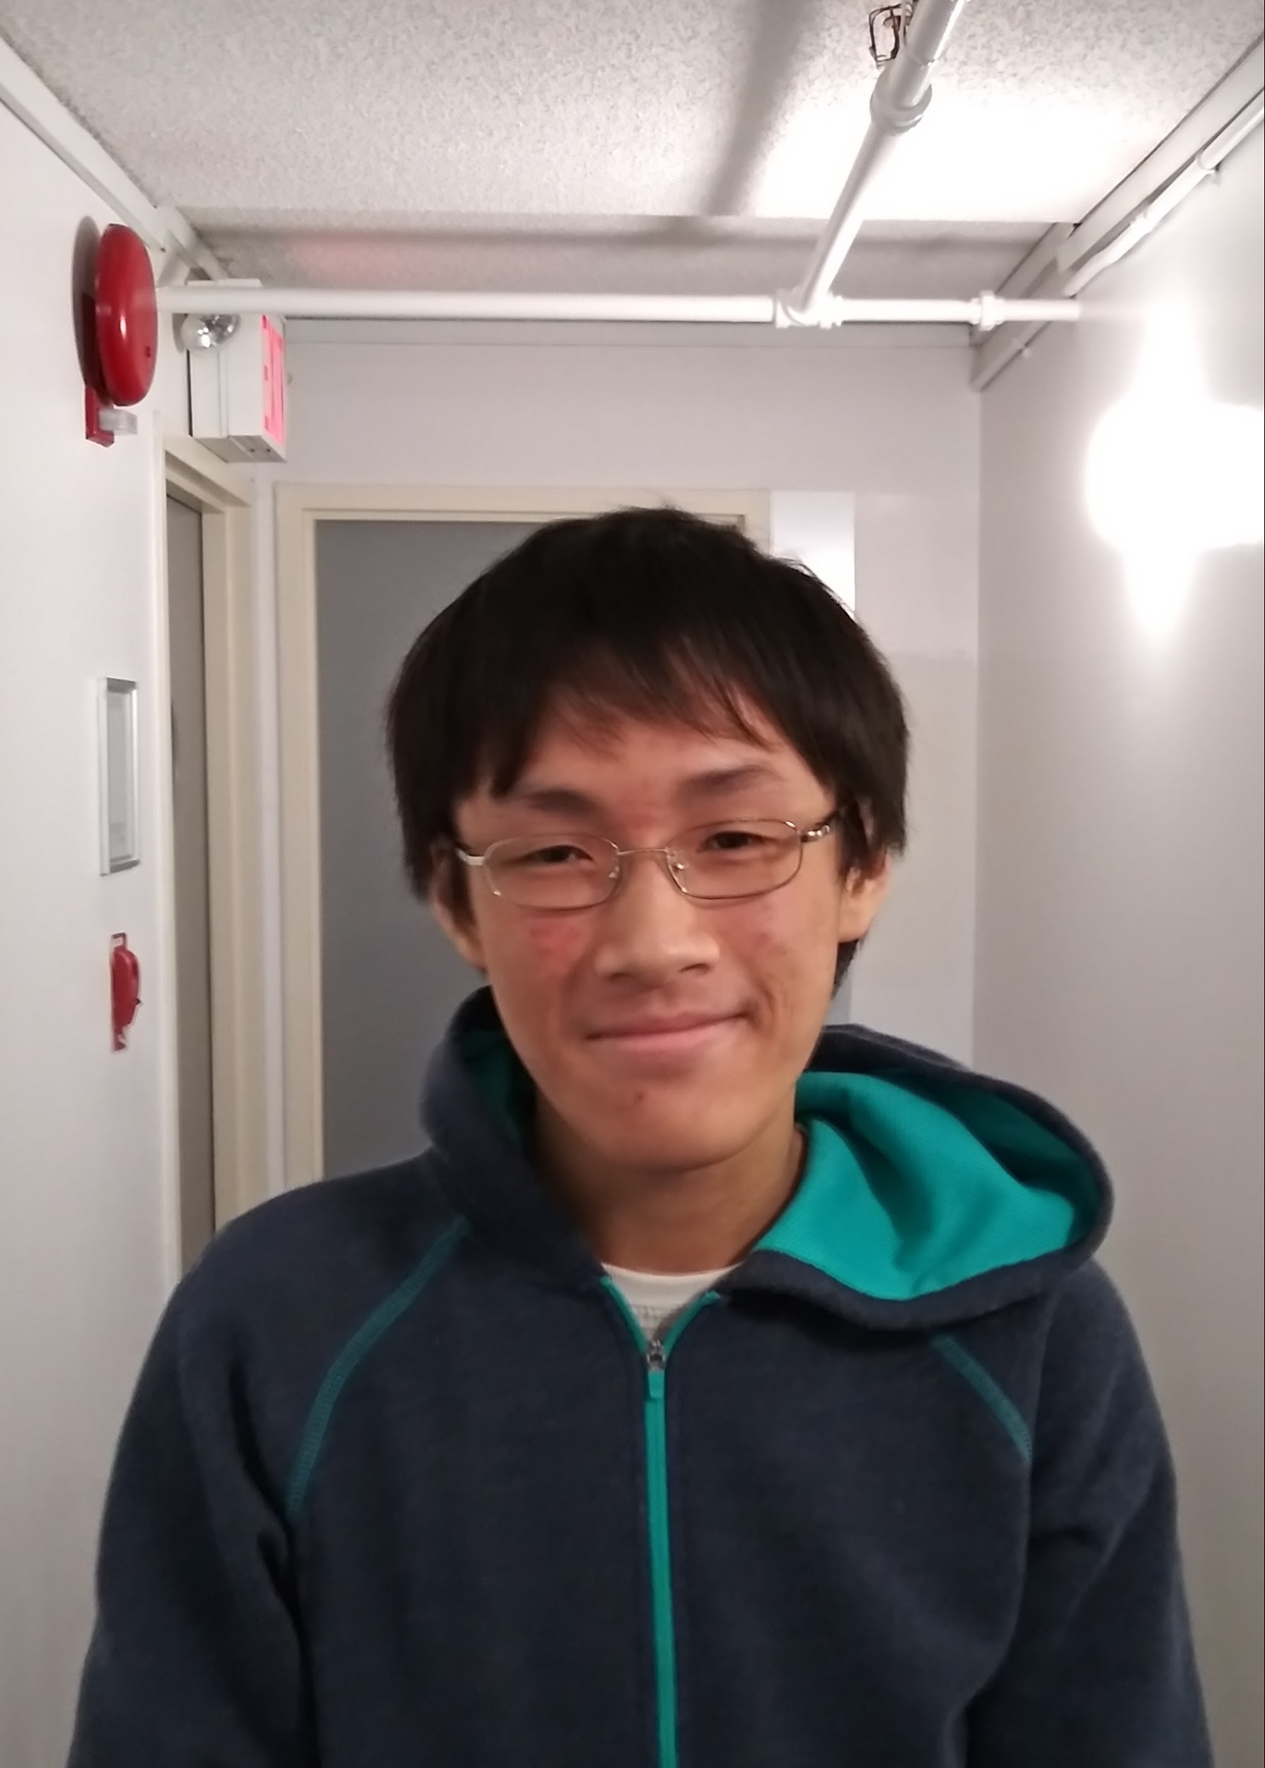
Task 2: Diabetes Education
Group 1
Group 2
Harper C-B.
Pia R.
Brandon H.
Derek L.
Notes:
Pia
Preventative diabetes education and the education and support of diagnosed diabetes in regards to self care

Slide 11
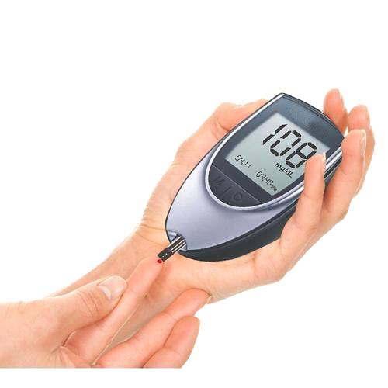
Task 1
Problem Formulation
Low-cost, sustainable glucose management device for people in Kampala
* http://www.diabetesforecast.org/2012/jul/the-cost-of-test-strips.html
$0.40+ per test strip*

Slide 12
Task 1, Group 1
Abstraction / Synthesis
Colorimetric paper strips with solution
Glucose oxidase + indicator
Easily detect changes in color
150 mg/dL
120 mg/dL
Notes:
Overview of our solution, how it works, and why this is a good solution
Builds off a working model (from last year), have feedback about what they wanted to improve most from them
Cheaper than electrochemical test strips, which require electric power and a precision machine (glucometer) and expensive test strips (w/ valuable metals on them)
Simple visual determination of blood sugar levels w/ a guide (similar to pH readings), potentially an app to boost accuracy
Briefly mention how we came up with this solution (i.e., basic overview of Duncker diagram)
Mention how smartphones are prevalent enough (include stat.) that we can make an app

Slide 13
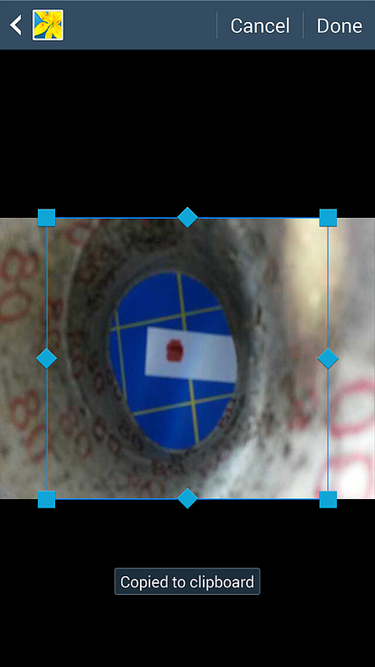
Methodology
Analysis
Testing different reagents for glucose
Testing different indicators
Testing color analysis algorithms
Last year’s app
Notes:
Reagents: e.g., glucose oxidase (ctrl), benedict's solution, fehling's solution, even yeast (?)
Indicators: e.g., iodine (ctrl) w/ glucose oxidase, redox indicators, acid/base indicators, perhaps other indicators for other solutions
Algos w/ statistics, improvements from last year w/ more datapoints, ctrls, etc.
Miscellaneous changes: messing around with paper, working with ways to filter out red blood cells
Mention how we are going to split up roles and teams (i.e., brief verbal overview of GANTT chart)
Testing methods: using simple glucose models for chemistry and simple color tests for image processing for calibration before moving on to real blood

Slide 14
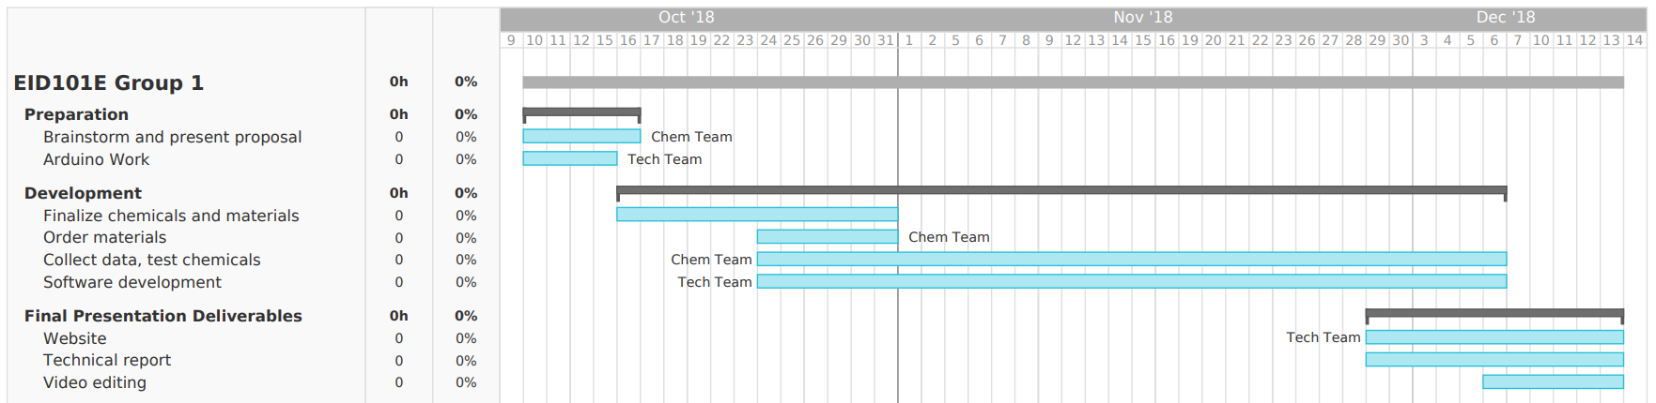
Progression & Cost Analysis
Preparation
R&D
Website, Report, Video
Item | Cost for Consumer
Chemicals/Materials | < $0.01 / strip
Software and Information Distribution | $0

Slide 15
Task 1, Group 2
Analysis
Non invasive urine and breathalyzer testing.
Communal approach to diabetes management.
Notes:
Currently we are on the abstraction and synthesis portion of the design process; that is, we have created different solutions to the problem facing us and are developing the ideas into concrete devices / solutions. While the task 1 group 1 are focusing on a blood based approach, our group has decided to focus on a more non-invasive approach. We will be pursing using urine glucose testing and breathalyzer acetone testing for diabetes management and pre-diagnosis.
//we have to add cost analysis

Slide 16
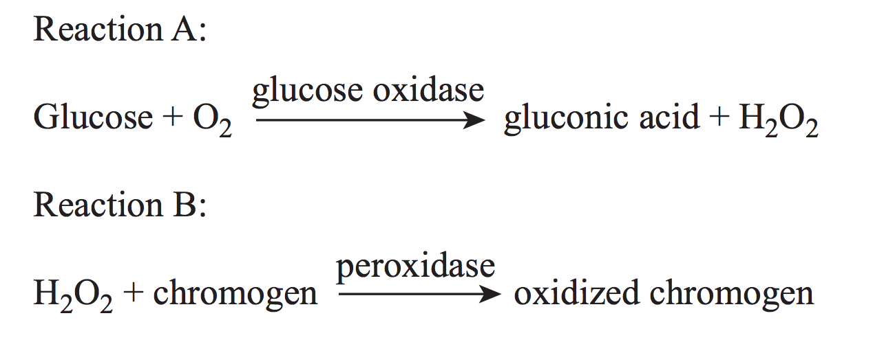
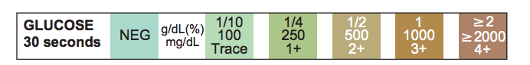
Urine testing Cost analysis: ~ $0.01
Analysis/Methodology
http://downloads.lww.com/wolterskluwer_vitalstream_com/sample-content/9781582558752_Mundt/samples/Chapter_04.pdf
Notes:
To test the urine we will be using a colormetric method, glucose can be found in the urine of diabetics and a glucose oxidase reaction will be used to create gluconic acid and hydrogen peroxide. We then use a peroxidase reaction to create a color spectrum which will tell concentration of glucose in the patient’s urine. A communal approach will minimize the chance that a patient will misread the test resulsts or perform the test incorrectly.

Slide 17
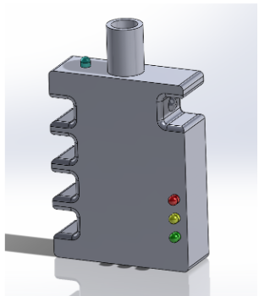
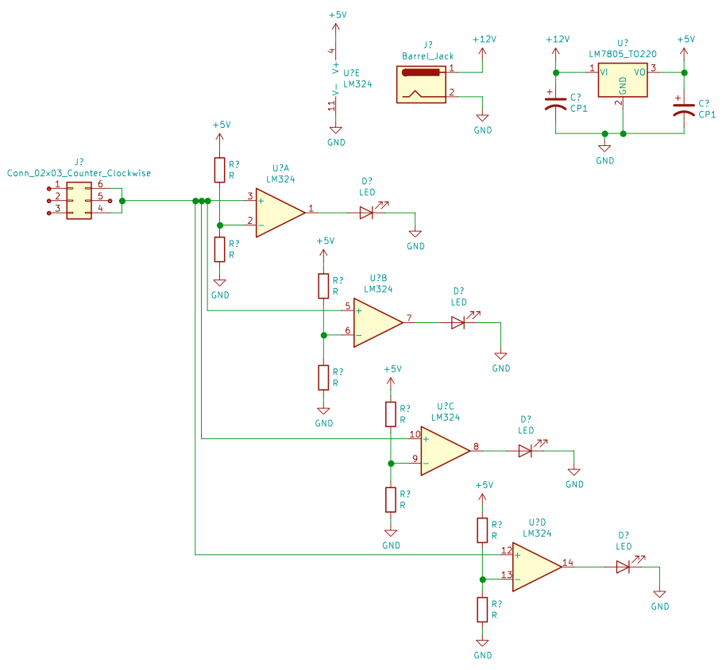
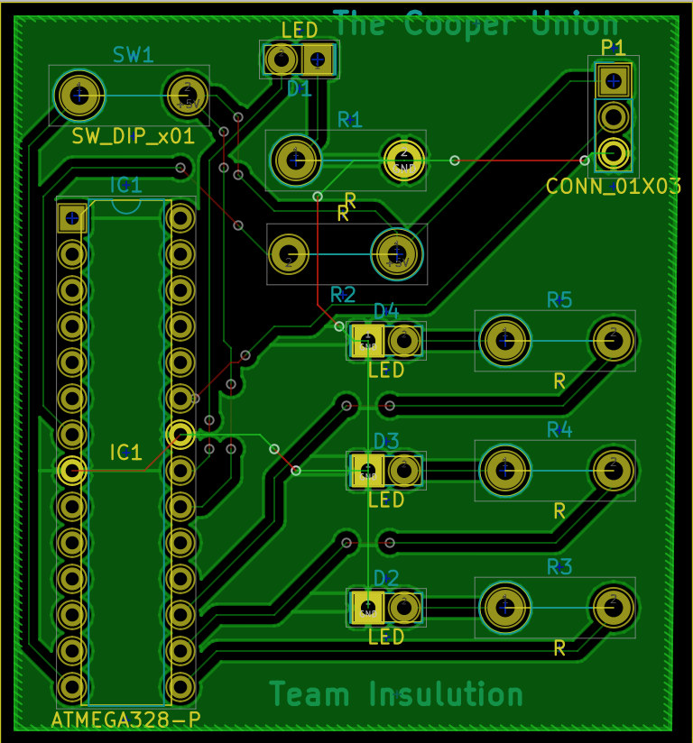
Acetone Breathalyzer
Analysis/Methodology
Measure Acetone content in breath.
Notes:
Our other option is to develop a user-friendly acetone breathalyzer to monitor glucose levels. Research shows that acetone levels in breath is a valid way to measure progression of diabetes; when the body cannot metabolize glucose, it instead burns fat for fuel. Some might say, wow this is great! You burn fat for fuel! However, this produces harmful ketones, namely acetone; acetone is excreted through urine and through breath. So using a cheap breathalyzer to measure the acetone content would be useful. This would work similar to an alcohol breathalyzer; essentially, you press the button on the side of the device to tell an acetone sensor to start sensing, and it will output a voltage that corresponds to the acetone content in the air. You can take this voltage, process it, and then output to a range of LEDs that correspond to the user’s glucose level. For example, red can mean danger, yellow can mean too low blood sugar, and green can mean healthy levels of blood sugar. These diagrams depict the development and progress made into this idea. Creating a breathalzyer is advantageous in that it does not require constant replacement of strips to function, and that these electronics are relatively low-cost. In addition, incorporating a solar panel to provide the power rail for the breathalyzer would result in a self-sustaining device capable of measuring glucose levels in a patient.
Use an Op-Amp Comparator to compare two input values, see which one if greater, use resistor values to change the reference voltage, and have it at different values depending on the output of the comparator.
Low-cost, user friendly, locally produced.

Slide 18
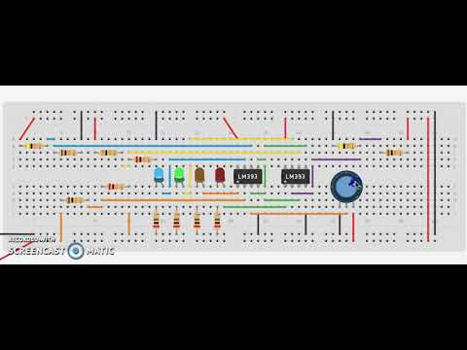
Acetone Breathalyzer
Parts List:
Solar panel: ~$5, ~$3 for electronics, ~$10 housing
Notes:
Cost, sustainable, easy to use, and safe to use.

Slide 19

Task 2
Problem Formulation
Self-care technologies and preventative education
Notes:
Why is this problematic? Less than ideal education in regards to all disease, not just diabetes No education means no prevention….people don’t know which behaviors could increase their chances of getting Type 2 diabetes. People also don’t have the means to carry out treatments properly, both bc of a lack of time and knowledge
and bc of the lack of accessible medical professional support, all of technologies have to be able to be used by the individual with as little professional help as possible

Slide 20
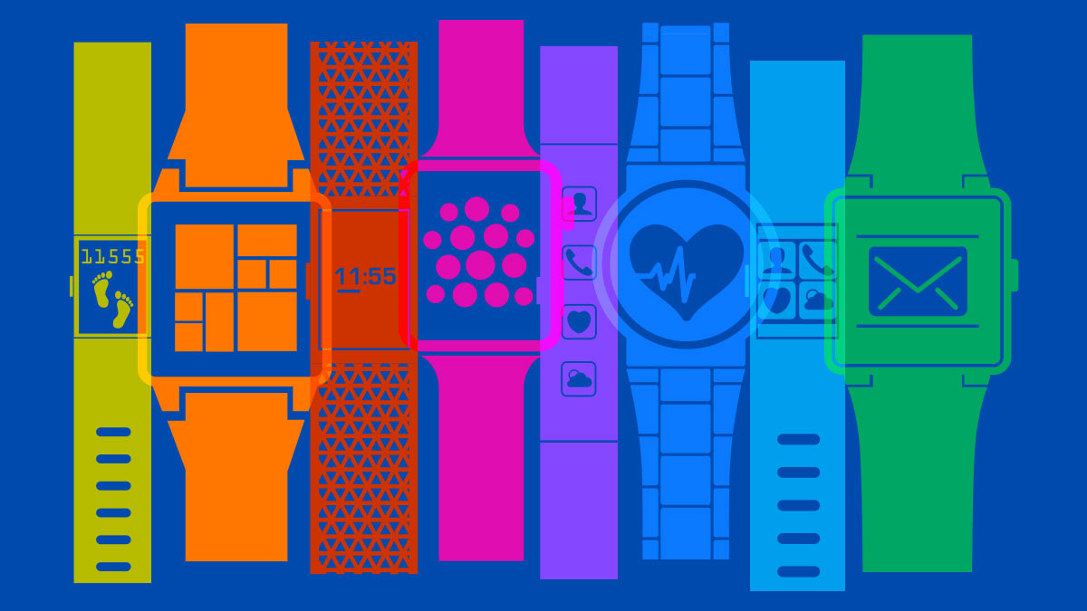

Task 2, Group 1
Abstraction
Solutions:
Wearable tech
Educational app
Notes:
Treatments for diabetics aren’t the most complicated, but in busy schedules it can be difficult to remember to take insulin, exercise, eat something or to test your blood sugar. So, we are going to make a reminder system.
If a patient had a simple reminder to just think about whatever it is that they need to do for their treatment, this will already greatly improve the rates of successful treatments. Basically modelled off of the success of the fitbit. Having something to act as a reminder helps promote healthier day-to-day choices.
The best way to help diabetics? Prevent more people from getting the disease through education. An additional upside is that a general population that understands the disease can be more of a support system to those individuals who actually have it. Also, the app can serve as another reminder tool for suggestions to make sure treatment stays on track.
Games like Dumb ways to Die (Australian MTA PSA to keep people safe around trains) and Re-mission (cancer-fighting video game marketedt towards kids currently in treatment) showed how by simply showing people incorrect behaviors, the incident rate dropped, as well as the more a patient knows about their disease, the more likely they are to be a helpful voice in treatment

Slide 21
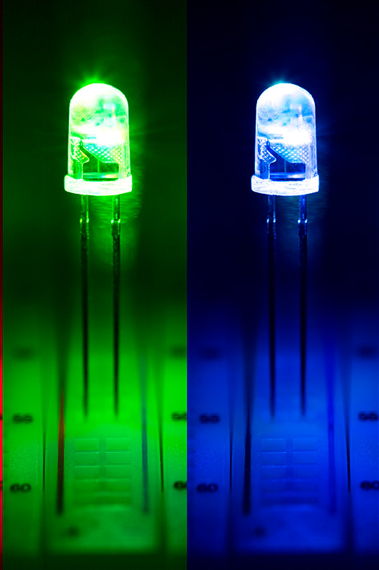
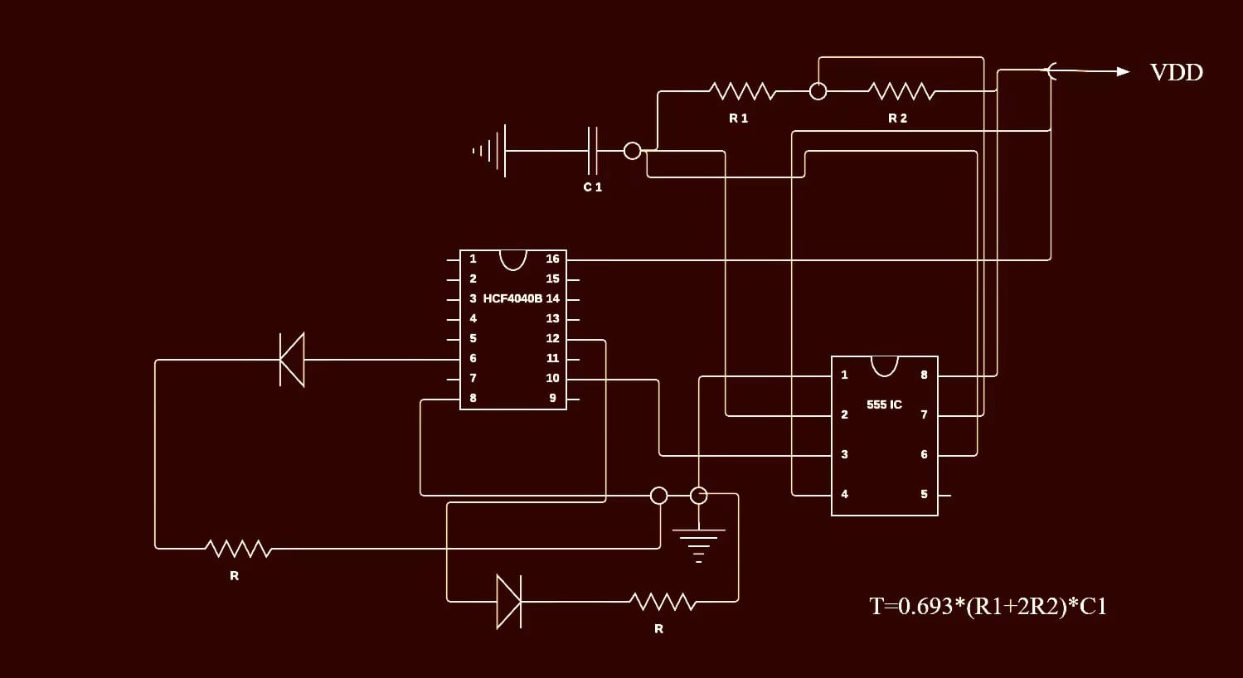
Wearable Tech
Analysis/Methodology
The Tech
555 timer, potentiometer, and counter
Solar powered
Notes:
Ideally, we would have a product with sensors and a large display that could monitor a patient's metabolic processes and suggest specific activities at specific times.
In order to create a system that would light an LED (as a standard), every eight hours, we will be using a 555 timer. A potentiometer will be included to allow users to change the frequency the LED is lit at.
We will need to experiment with resistors and capacitors in order to make the 555 timer work for the length of intervals we need. Most 555 timers work for intervals of about 20mins, and if we cannot make it work with a reasonable of resistors and capacitors, we will have to use a counter that will essentially keep the LED from lighting until it receives a certain amount of signals from the 555 timer. We will have to experiment with both of these options and see what is the most reliable, allows for adjustment by the individual, and can be fit in the compact space we have.
Also, we hope to use a small solar panel to power this device, but that also requires a more detailed analysis of how much electronic components we can fit in such a small space.

Slide 22
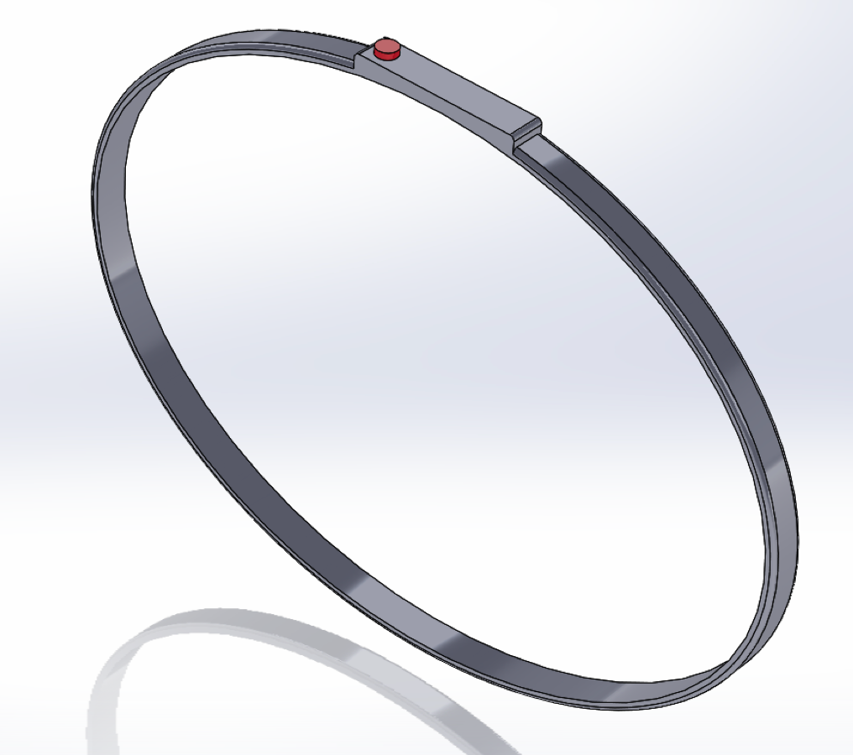
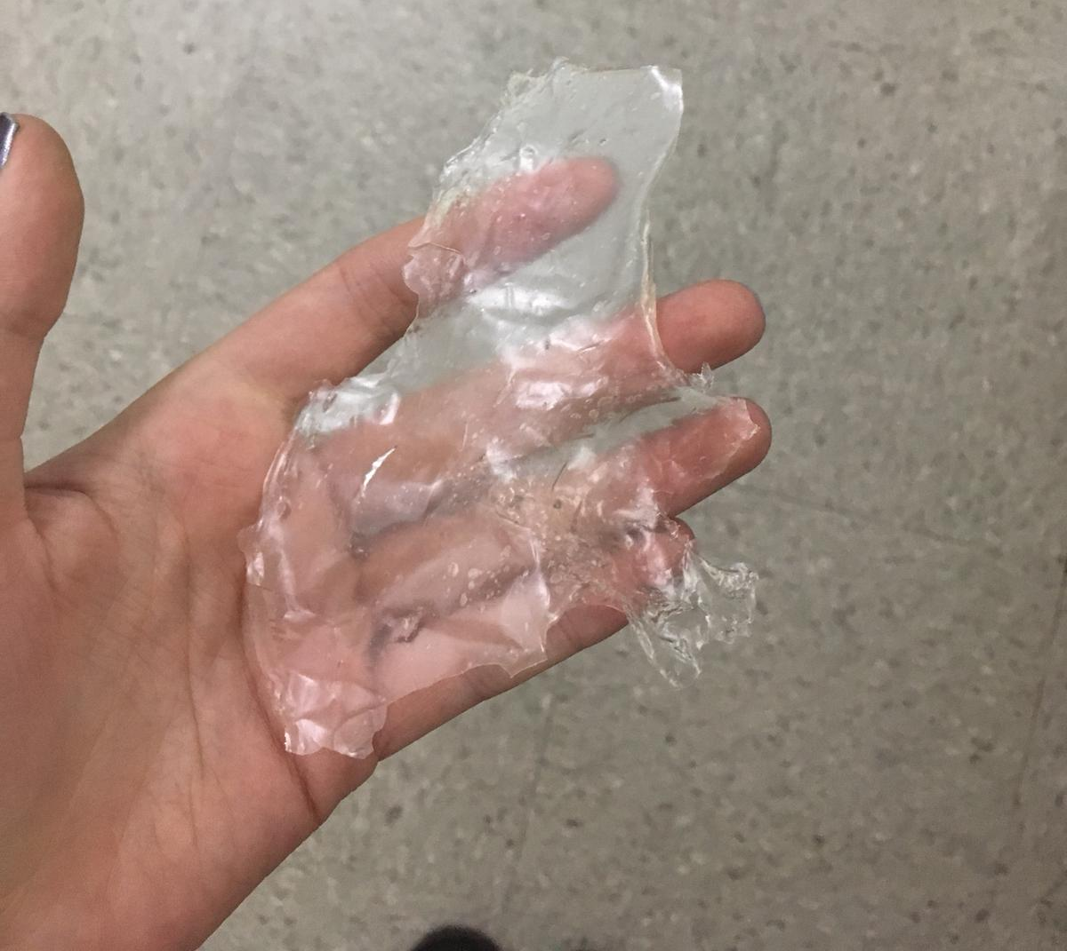
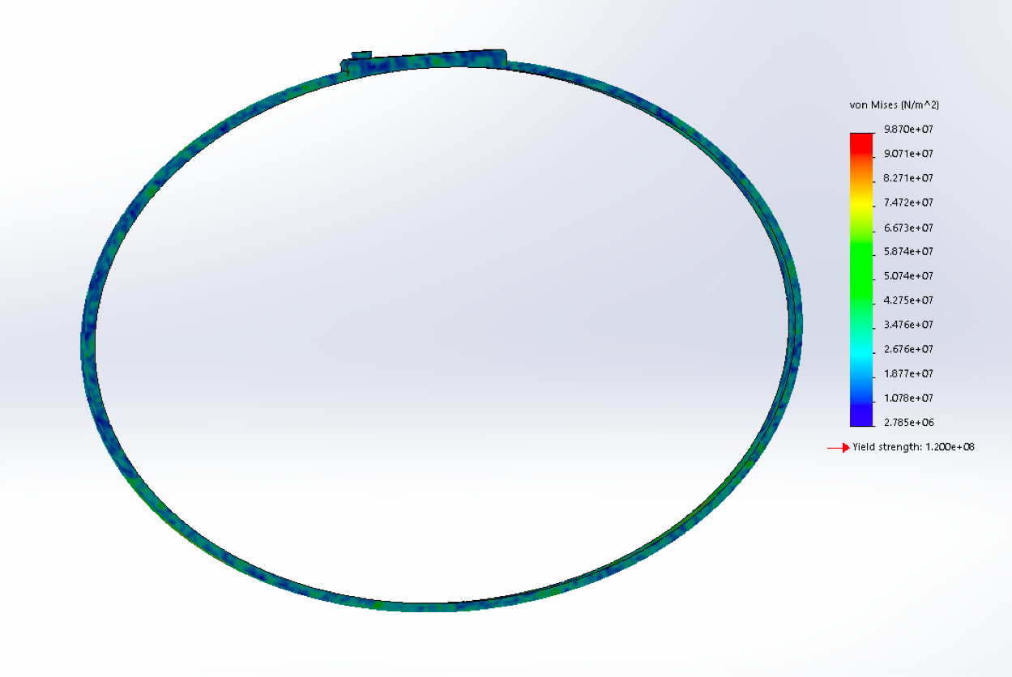
Wearable Tech
Analysis/Methodology
The Wristband
Locally, reproducible bioplastic
Cost analysis: ~$10
Notes:
We want the band of our wearable tech to be environmentally safe, locally reproducible, strong and weatherproof. It also has to be safe and comfortable enough for someone to wear it on their wrist for large periods of time. A fitbit is quite comfortable, but that plastic will be on the earth forever. So, we decided to begin working with bioplastics.
We began some experiments with bioplastic, creating thin plastic sheets composed of vinegar, glycerin and starch. Though we did create a waterproof plastic material, as seen above, the molding capabilities are slim to none of this material as it takes too long to cure. Also, the material smells of vinegar (which is not ideal), and either because of the composition of the material or the lack of proper equipment (we weren’t sure if we were getting the plastic hot enough and couldn't cure it properly), the material wasn’t strong enough or the correct consistency for what we need
Our next steps are to continue working with bioplastics, exploring ones that are already manufactured or maybe creating our own recipe while consulting a plastics expert. After we find a suitable plastic, we will make a 3-d printed model of our wristband and use that to create a silicon mold that we can use to make the band out of plastic. The electronic component of tech will be set in the plastic using a wireframe.
The inclusion of all our parts, including the list of electronics on the previous slide and the wristband should fall under 10$. Most of the elctronic components can be sourced from the electronics labs around the school, lowering our costs even more

Slide 23
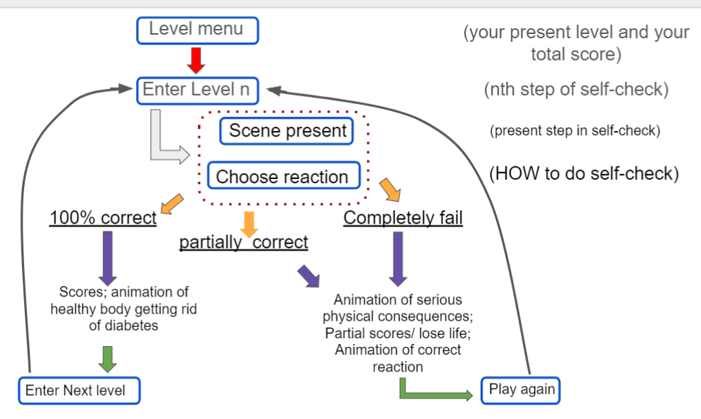
App
Analysis/Methodology
General
Treatment standards
Exercise
Diet
Notes:
For prevention education: an app
-one download
-flash link that can be used with internet or downloaded on a device
-using levels to encourage further game play, with the basic format (point to graph). If a level is done completely correctly, a player is presented with why those were the correct choices and advance to the next level. If partially correct, the incorrect information is pointed out and the player is prompted to redo the level. If all the answers are incorrect, the game automatically restarts with some basic explanation of facts that could serve as “hints” to the answer.
-We have a list of facts that range from General information about the disease itself to some diet and exercise suggestions
-next steps are to develop level specific game-play, as we want it to vary as much as possible and to see which of our facts can be combined into levels regarding similar information
-we are aiming to have a ten level game

Slide 24



Task 2, Group 2
Synthesis
Water Purification and Diabetes Education
+ Ca(ClO)₂ + Activated Carbon
25% or 350,000+
No access to clean water
Notes:
Chlorine salts:

Slide 25
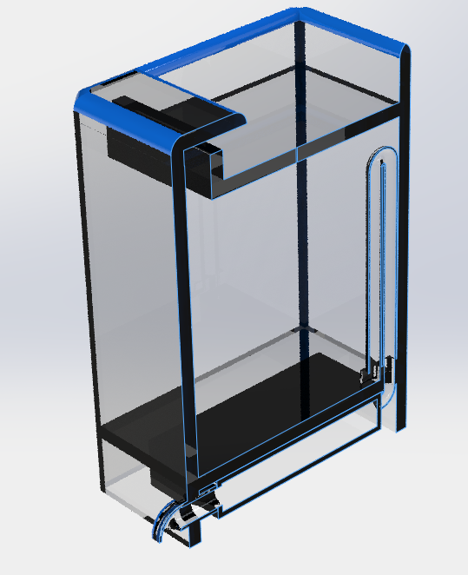
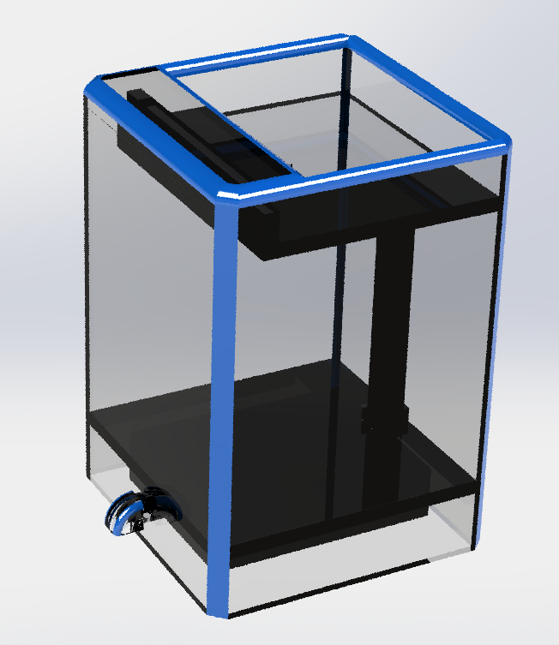
Purification Methodology
Analysis
Testing the amount of charcoal and chlorine needed
Create a siphoning method
Cost: ~$15-20
Notes:
Chlorine salts:

Slide 26
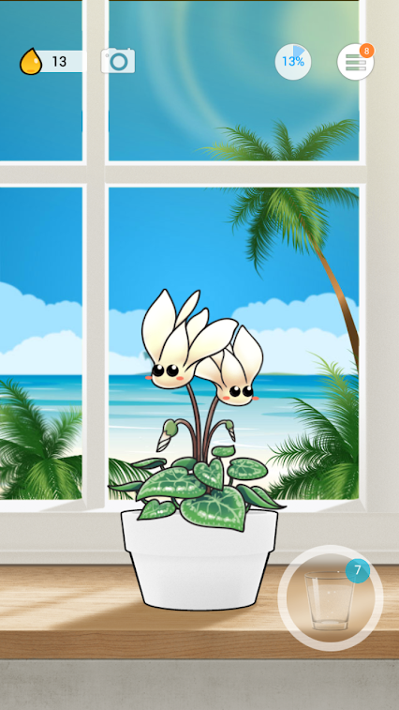

App Methodology
Analysis
Creating a compatible sensor on filter
Program app
Notes:
Chlorine salts:

Slide 27
Acknowledgements
Professor Raja
2016 and 2017 EID 101E Group
Diabetes Research Team at Albert Einstein College of Medicine and Johnson&Johnson
Mr. Liva of Bergen County Academies
Notes:
We would like to acknowledge Professor Raja

Slide 28
Thank You!
Emily Y., Jonathan L., Joshua Y., Radi F.,
Derek L., Brandon H., Harper C-B., and Pia R.

